Slide 2

SUPPORT BRIEFER PRESENTATIONS
RG, p. 16

Slide 3
Skillbridge Program
Apprenticeships, on-the-job (OJT) training, employment skills training, and internships for Airmen (officers and enlisted) to prepare for transition to civilian employment
ELIGIBILITY:
  Airmen can start a program within 180 days of DOS
  Must receive commander approval
Permissive TDY is authorized. AFPC/DP2SST approves all PTDY requests exceeding 30 days
Airmen approved for training outside the local area can request expedited orders and out-process/ship HHG prior to SKB
Permissive TDY for separation or retirement relocation activities, terminal leave, or CSP/SKB cannot exceed a total of 180 days and may not begin more than 180 days prior to separation or retirement
Airmen who applied for but have not completed a credential through AF COOL will be denied a SKB program leading to the same credential

Slide 4
QUESTIONS?

Slide 5
Separation History and Physical Examination (SHPE)
DSN: 452-8110
SHPE Coordinators

Slide 6
What is a SHPE?
Provides a separation examination that supports the Department of Veterans Affairs (VA) disability compensation program and the Department of Defense (DoD) mandatory separation history and physical exam.
  A standardized health assessment with components that have been agreed upon by all three Military Services and the VA.
  Allows for a medical evaluation of each Service Member prior to separation from Active-Duty service.
What’s the benefit of a VA SHPE?
  Examinations completed by the VA benefit the member by initiating the disability claims prior to separation. Exams with the VA completed within 180-90 days prior to separation, qualify for Benefits Delivery at Discharge (BDD) program.
Notes:
As you probably know Col Weggeman no longer requires FSS to present metrics on evals turned in 5 days after close out. It's now reported only 30 days after close out; however, per Col Bowersox the MDG suspense is still 5 days after close out.
It's on the T shared drive
Where everyone has access
Created by Group
Updates are entered by squadron Supts and/or secretaries

Slide 7
Who requires a SHPE?
All AD SMs who are scheduled to separate (which includes retirement) after serving on AD orders for 180 days or more.
AD SMs who have received tentative approval for Palace Chase transition.
Reserve Component (RC) members who are scheduled to end a period of AD service for 180 days or more of continuous duty (e.g. Active Guard Reserves (AGR), Military Personnel Appropriation (MPA) tours).
RC members who are scheduled to end a period of AD service after >30 days of continuous duty in support of a contingency operation (as identified on their orders).
Notes:
As you probably know Col Weggeman no longer requires FSS to present metrics on evals turned in 5 days after close out. It's now reported only 30 days after close out; however, per Col Bowersox the MDG suspense is still 5 days after close out.
It's on the T shared drive
Where everyone has access
Created by Group
Updates are entered by squadron Supts and/or secretaries

Slide 8
Who requires a SHPE?(cont’d)
A SHPE is NOT required if:
  The member is separating or retiring after being found unfit and is referred to the Disability Evaluation System (DES).
  NOTE: Initial Review in Lieu of (IRILO) or referral to a Medical Evaluation Board (MEB) does not negate the SHPE requirement. MTF staff must wait until the MEB decision is established in order to determine if the SHPE is required.
WAIVER
  The SHPE may be waived in cases that the member is not under the control of the Secretary of their Military Department or the Commandant of the United States Coast Guard (USCG), such as unauthorized absences or civilian incarceration, in accordance with (IAW) DoDI 6040.46. The Secretary of the Air Force (SECAF) is the waiver authority for AF members.
Notes:
As you probably know Col Weggeman no longer requires FSS to present metrics on evals turned in 5 days after close out. It's now reported only 30 days after close out; however, per Col Bowersox the MDG suspense is still 5 days after close out.
It's on the T shared drive
Where everyone has access
Created by Group
Updates are entered by squadron Supts and/or secretaries

Slide 9
TIMELINE
Members will adhere to the SHPE timeline, specified below, to help prevent unnecessary appointments, adjustment of terminal leave, or delay of BDD.
The member’s official date of separation cannot be changed in order to accommodate the completion of the SHPE, but terminal leave may be adjusted with approval from the SM’s unit commander (CC):
  Filing a VA Claim:
  Greater than 180 days prior to separation or retirement- Begin preparing for the claim process. Contact local VA representative.
  180-90 days prior to separation or retirement- Go to https://imr.afms.mil/imr/MyIMR.aspx and complete DD Form 2807-1. Contact local VA office to begin claim process or file online at https://www.ebenefits.va.gov/ebenefits/homepage.
Notes:
As you probably know Col Weggeman no longer requires FSS to present metrics on evals turned in 5 days after close out. It's now reported only 30 days after close out; however, per Col Bowersox the MDG suspense is still 5 days after close out.
It's on the T shared drive
Where everyone has access
Created by Group
Updates are entered by squadron Supts and/or secretaries

Slide 10
TIMELINE (cont’d)
Not Filing a VA Claim?
  180-90 days prior to separation or retirement- SHPE will be conducted at the Medical Treatment Facility. Go to https://imr.afms.mil/imr/MyIMR.aspx and complete DD Form 2807-1.
Less than 90 days prior to separation or retirement:
  Due to DoD/VA policy, SHPE will need to be completed at the MTF. Go to https://imr.afms.mil/imr/MyIMR.aspx and complete DD Form 2807-1 to initiate the SHPE process.
  A VA claim can still be processed, however any VA exams conducted will NOT be able to take the place of the SHPE and may not be completed prior to separation. VA benefits may also be delayed pending VA exams.
Notes:
As you probably know Col Weggeman no longer requires FSS to present metrics on evals turned in 5 days after close out. It's now reported only 30 days after close out; however, per Col Bowersox the MDG suspense is still 5 days after close out.
It's on the T shared drive
Where everyone has access
Created by Group
Updates are entered by squadron Supts and/or secretaries

Slide 11
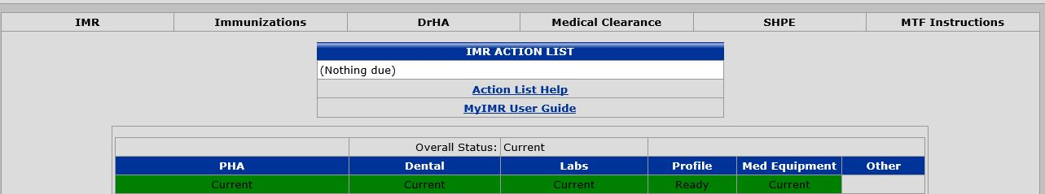
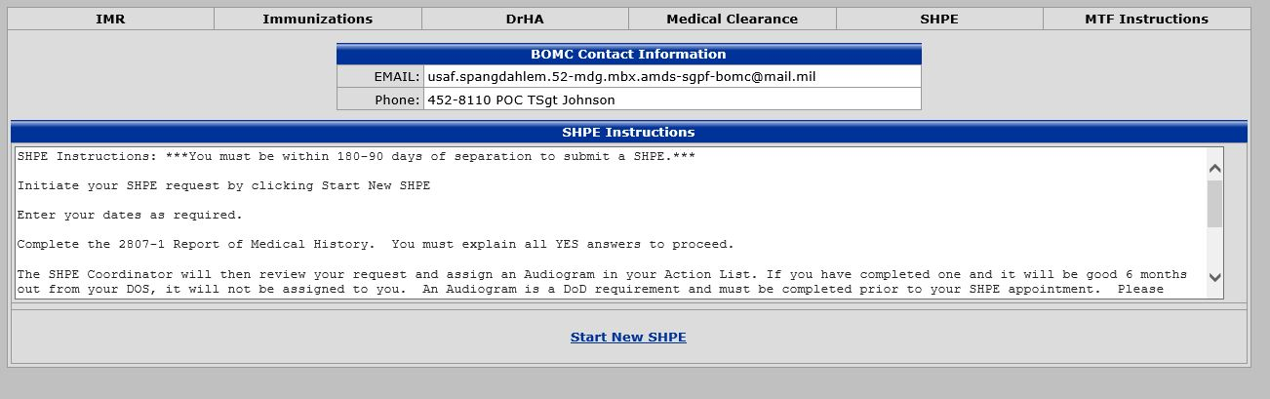
My IMR Guidance
1.
2.
**READ ME **
2

Slide 12
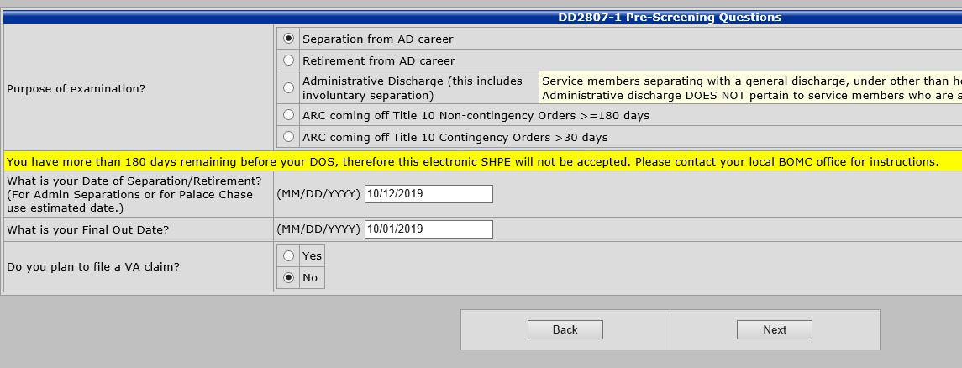
My IMR Guidance
3.
End of Enlistment contract (Don’t forget the forward slashes
Possible Terminal leave start / Leave for Skills Bridge Program / MPF Final Out
DO NOT LEAVE DATES BLANK!
Clicking NO above allows MHA questions automatically
** Does NOT affect your VA claiming process**
2

Slide 13
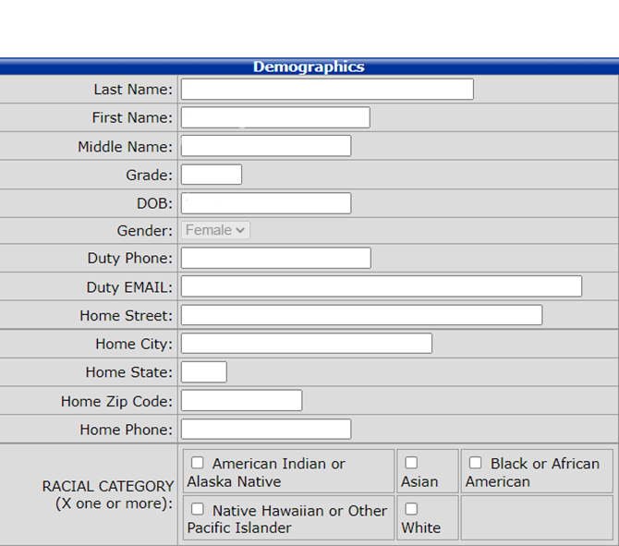
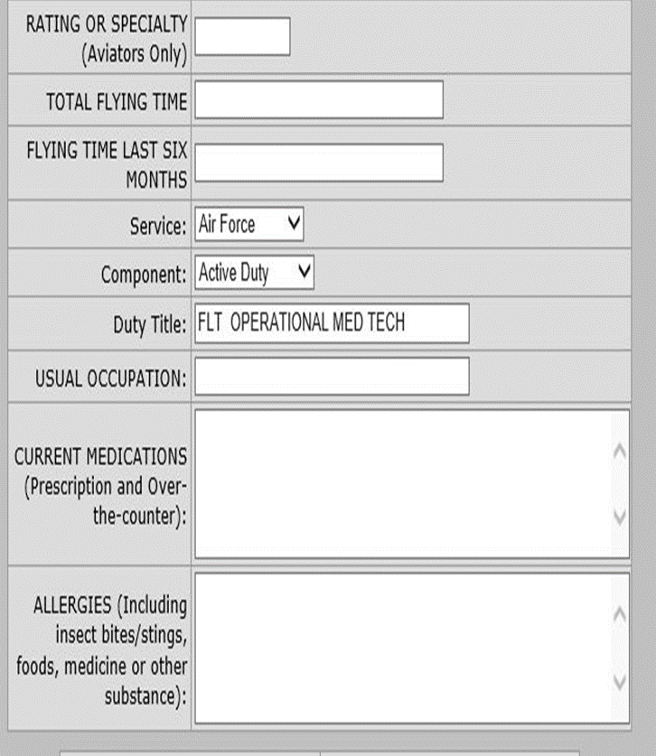
MyIMR Guidance
4.
NO Phone Trees
Military Email only
2

Slide 14
Separation Memorandum
You will be required to bring in your Memorandum to Flight Medicine Clinic for signature AFTER your Audiogram/PCM visit.
** Memorandum is a requirement for Final Out process **
To locate this form please look into your Retirement/Separation email that was sent from MPF.

Slide 15
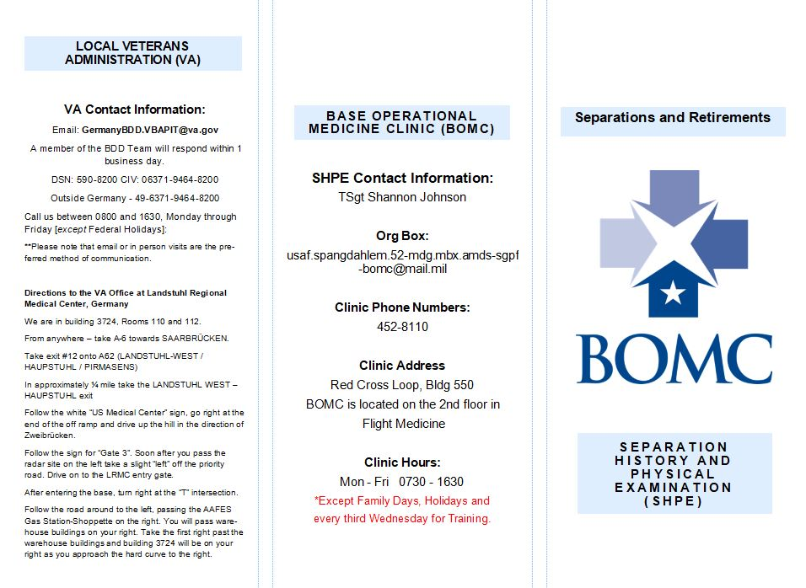
2

Slide 16
Questions?
2

Slide 17

Separation & Retirement
Military Pay
Last updated: 16 October 2023

Slide 18
Agenda
Required forms
MyPay
Finance “Final-Out” - SharePoint
Terminal Leave
Permissive Leave
Entitlements
Debts
Travel Voucher
Final Paycheck

Slide 19
Required Forms
52CPTS Separation/Retirement Checklist
  Access through the SharePoint
52CPTS Separation/Retirement Package
  You must access and complete this from the SharePoint
Leave Forms (AF 988’s)
  Terminal / Permissive – Finance will print them for you.
Copy of Orders
Notes:
Get out of your comfort zone.
Don’t assume you know the finish line
Continue to challenge yourself
But master one job before moving on
Technical, Leadership, Educational Opportunities
Make the most of every opportunity
Take ownership and responsibility.
Your work is a reflection of you
Seek to improve “YOUR” products/process
Accept responsibility/accountability for short comings
When you are the Boss – Give ownership
Ownership & Accountability must be linked
Focus on Today while driving towards tomorrow.
Grow where you’re planted
No job is more important than your current job
Success now will lead to opportunities later
You’re filling your toolbox – every job adds to the kit
Be a true Airman…
Leadership, core values, strong work ethic, sacrifice
Do your job…Well
Know your Air Force
Doctrine, Strategy, Mission
Budget Priorities
Heritage – Every base / location has a story
Professional development
PME / CDE
DoD FM Certification
CSAF reading list

Slide 20
MyPay
Please create a MyPay Account before Separation/Retirement
Steps
  1. Log into MyPay with CAC
  2. Click Personal Settings in top right screen
  3. Add Password and Login ID
  4. Log out and check if login info work
Use of MyPay for LES Updates when on Terminal and Retirement
If already created account please don’t worry about these steps

Slide 21
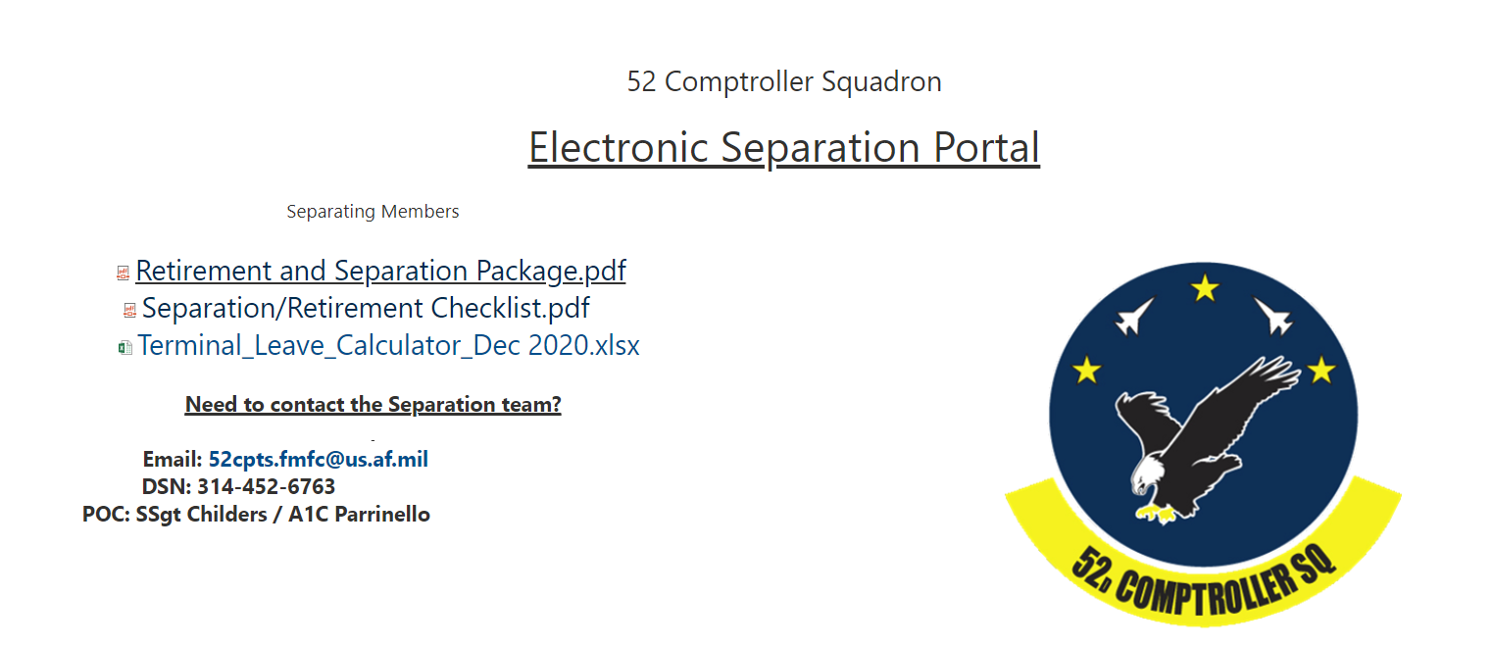
SharePoint Instructions
Open PDFs and download attachments
Link: https://usaf.dps.mil/sites/52fw/Finance/SitePages/Separations.aspx

Slide 22
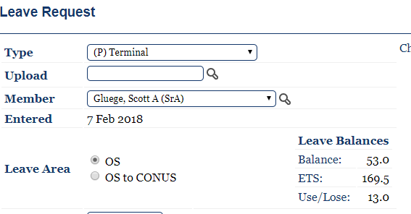
Terminal Leave
Everyone is authorized Terminal leave
It is charged from your leave balance
Type “P” for Terminal
Must be input to your
DOS. Not the day prior or after.
NOTE: If taking Permissive LV, start day for Terminal is the day after Permissive ends

Slide 23

Permissive Leave
Only retirees, HYT, and medical separations are authorized to take Permissive Leave.
Maximum of 30 days with Commander approval.
It is not charged to your leave balance – meaning its FREE
Input as type “T” in LeaveWeb
And use Rule 2 and checkmark in conjunction with Terminal

Slide 24
Additional Information for Leave
Your leave must be approved by your Commander in LeaveWeb prior to your Final Out
The leave authorization will be made by the Finance Office. There are no exceptions to this policy.
It is imperative that you out-process the finance office within 30 days from your final out with MPF.
CONCURRED Leave is not APPROVED Leave by Commander

Slide 25
Leave Sell
Any leave you do not take will automatically be sold back to the Air Force
You can sell a maximum of 60 days in your career
  If you have sold leave, please let us know.
Leave Sell is calculated as:
  (Base Pay/30) x (# of days of Leave) – (25% Fed Tax & State Tax) = Total USD for Leave Sell
  The State Tax % rate is specific to the state

Slide 26
Entitlements
If you remain in Germany:
  Your OHA will continue until your DOS unless you break your current lease. You will also continue to receive COLA.
If you remain overseas but break your lease:
  You will not receive any OHA, unless you start a new housing lease.
If you return to the USA:
  Your COLA will stop the day before you depart Germany and your BAH will start the day you depart from Germany.

Slide 27
Debts
All debts, including a security deposit advance, should be paid in full by your DOS
  If not paid the balance of the debt will be taken from the final paycheck.

Slide 28
Travel Voucher
All members are authorized travel allowances to their HOR if separating or HOS if retiring.
You will find the travel voucher in the Separation/Retirement Package
Retirees have 1 year from DOS to file their voucher
Members who separate have 6 months from their DOS to file their voucher
  Failure to submit a claim in this time period means you forfeit your claim against the government for travel expenses.

Slide 29
Travel Voucher Cont’d
Make sure to attach all copies receipts for travel when submitting the Voucher
Attach flight itinerary so we may confirm days of travel
Please read the back page of the Travel Voucher so it is filled out properly
  Failure to turn in a completed and corrected travel voucher will delay the process of reimbursement

Slide 30
Final Paycheck
If your DOS is before the 15th then you will not receive a mid month paycheck, if it is after the 15th you will not receive an end of month paycheck.
Your final payment will be issued to you within 20 - 30 days from your DOS.
If you haven’t received your final payment in that time frame please contact us.

Slide 31
Finance “Final-Out”
The Finance “Final-Out” must be within 30 days from your “Final-Out” with MPF
Required for Finance “Final-Out”
  Checklist
  Package
  Terminal/Permissive Leave Approved by your Commander
  Orders

Slide 32
Questions?
Please email our org box with any questions: 52cpts.fmfc@us.af.mil

Slide 33
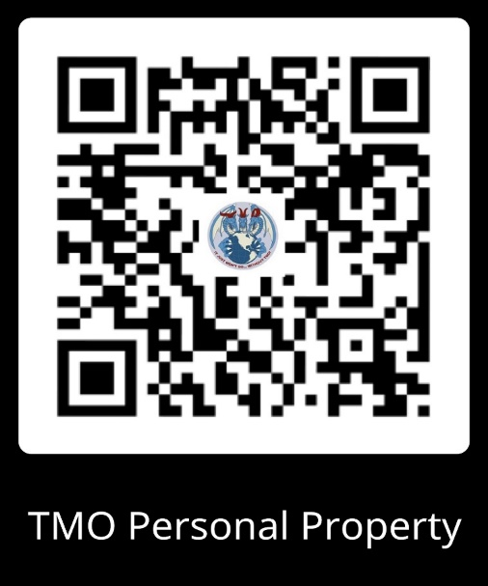
TMO Personal Property
Hours of operations:
MONDAY- FRIDAY
0800-1100 & 1300-1500
*Closed on the first Thursday of every month for training*
Bldg 103 Rm 18
Contact Information
DSN: 452-6065/6068
MUST HAVE ORDERS IN HAND!
Go to dps.move.mil and log on to DPS or create a new account
Fill out the Personal Property worksheet and send it to our org box 52LRS.LGRDF.PersonalProperty@us.af.mil with a copy of your ORDERS so we can get the process started to do the face to face briefing (we will contact you to set the appointment)
Entitlements:
  Home of Record (SEP) vs. Home of Selection (RET)
  Weight entitlement depends on rank and dependents
  Non-Temporary Storage SEP (6 months) RET (12 months)
  Alternate location will have to be done by Ramstein to find the price (please send us an email)
Scan the code or go to https://www.spangdahlem.af.mil/TMO/
to find the Personal Property Worksheet and more information regarding your move

Slide 34
PERSONAL PROPERTY
Traffic Management Office (TMO)
YOU MUST HAVE ORDERS TO START THE SHIPMENT PROCESS!!
Separations Entitlements
Retirements Entitlements
Authorized shipment locations (HOR, PLEAD, etc..).
Non-Temporary Storage duration is 6 months.
POV Shipment is limited to 1 vehicle (POC: VPC at DSN: 452-7265) NOTE: POVs are recommended to be shipped at least 90 days prior to departure.
if you are shipping alcohol please visit: “https//www.ttb.gov/wine/alcohol-beverage-control-boards”
Entitlements not used are valid up to 1 years.
Authorized shipment location is Home Of Selection (HOS).
Non-Temporary Storage duration 12 months.
POV Shipment is limited to 1 vehicle (POC: VPC at DSN: 452-7265) NOTE: POVs are recommended to be shipped at least 90 days prior to departure.
Are you choosing a HOS OCONUS?
if you are shipping alcohol please visit: “https//www.ttb.gov/wine/alcohol-beverage-control-boards”
Entitlements not used are valid up to 3 years.

Slide 35
Prohibited Items
Any controlled substance: narcotics, steroids, hallucinogenic drugs, amphetamines
Drug paraphernalia: Hookahs, Bongs etc…
Lithium Batteries: items that contain 100 watt hours or more. Commonly seen items to include but not limited to E-Bikes/Scooters, Power Tools, Lawn Care Equipment etc…
Meat Products: prohibited unless shipped commercially by USDA-approved packing plant.
Animal/Bird products: Trophies, skins, etc… Items may be imported if not restricted by US Fish & Wildlife.

Slide 36
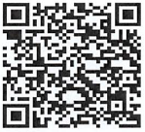
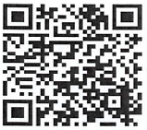
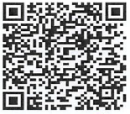
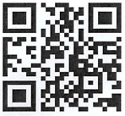
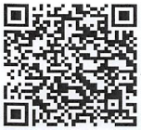





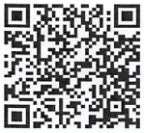
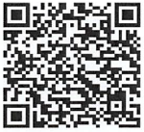
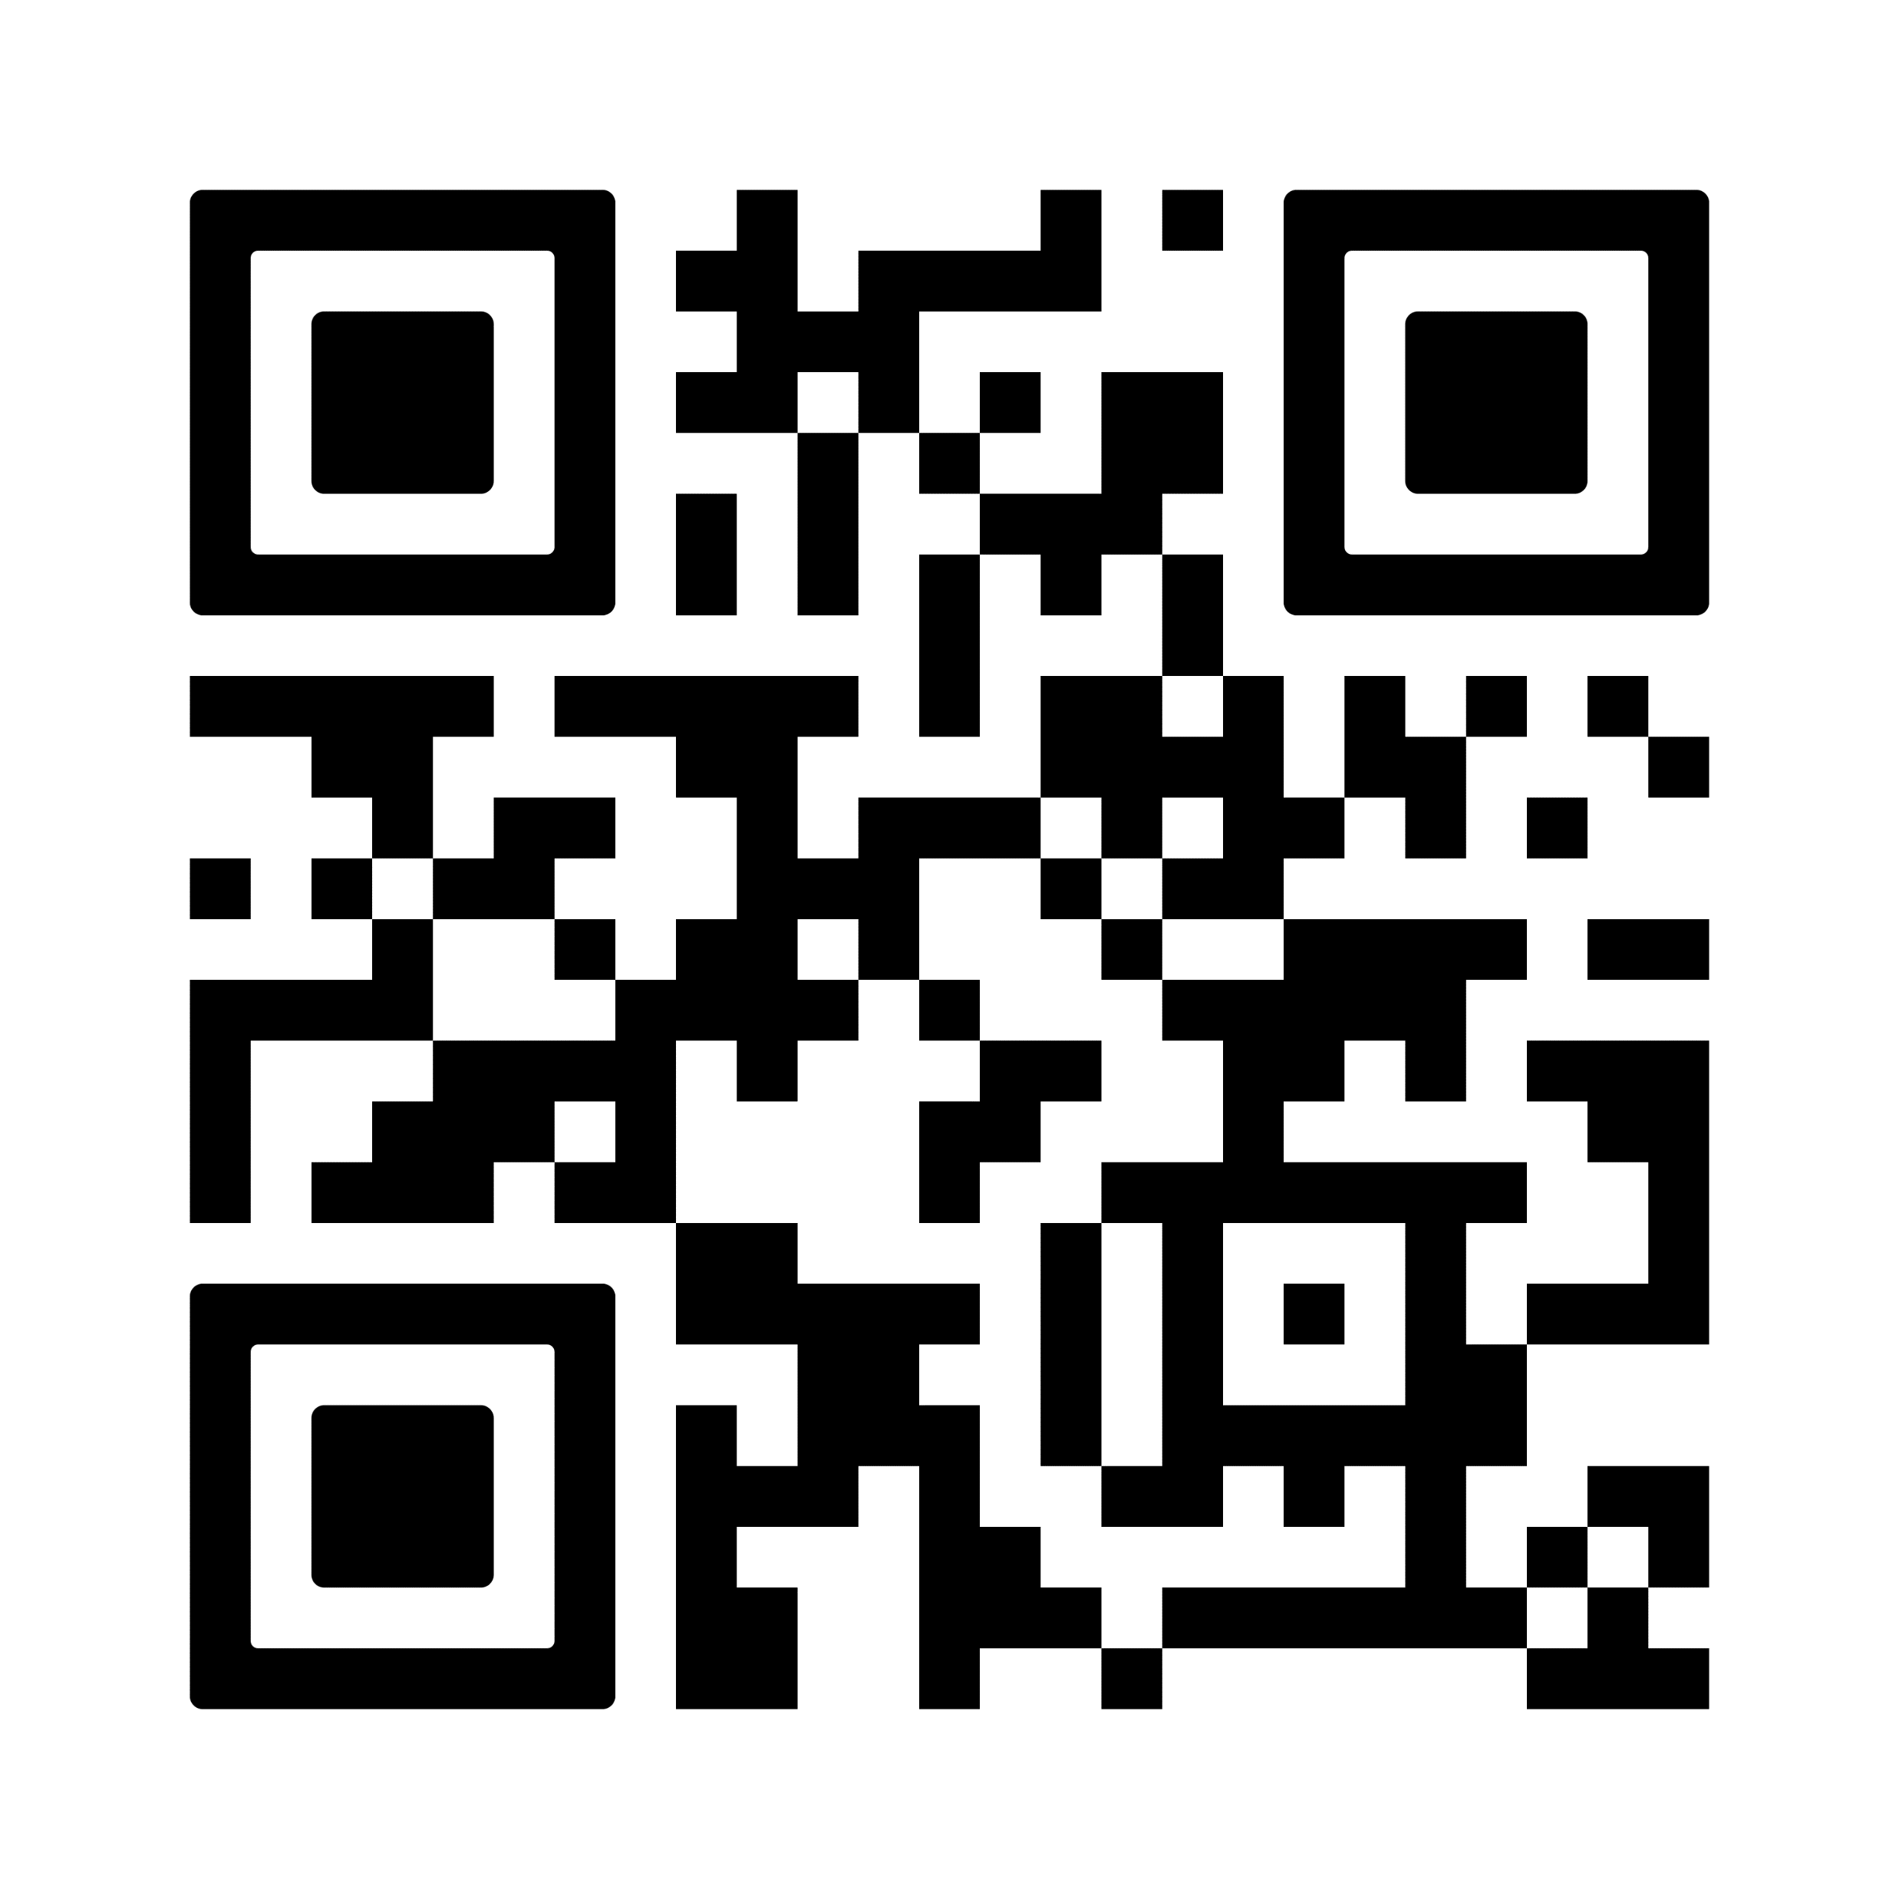
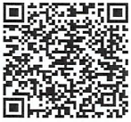
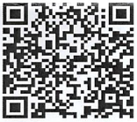





PERSONAL PROPERTY
Traffic Management Office (TMO)
INFORMATION QR CODE FOR NEXT MOVE
7 Day Window
It’s My Move
Customer Survey
POV Shipment
PPM
Inconvenience Claims
Claims
Lithium Batteries
Gypsy Moth
Mold

Slide 37
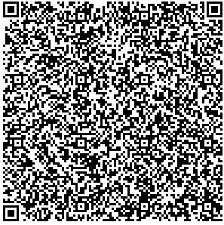
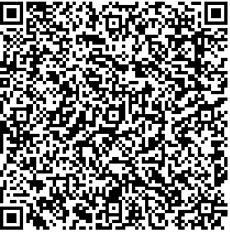


PERSONAL PROPERTY
Traffic Management Office (TMO)
Contact Information:
Email: 52LRS.LGRDF.PersonalProperty@us.af.mil
DSN: 314-452-6065 / 6068
Commercial: +49 6565-61-6068 / 6065
NOTE: Our office is CLOSED for all U.S. Federal Holidays, USAFE Family Days, and the 3rd Wednesday of each month for training.
Contact
Information
Email Us

Slide 38
Questions?
PERSONAL PROPERTY
Traffic Management Office (TMO)

Slide 39





52 LRS/TMO Passenger Travel Office
Authorized Destinations
Authorized Vehicle Port (Requires letter from VPC)
First Port of Entry (Baltimore via AMC).
Any deviations require circuitous travel. Request must be submitted to MPS 120 days prior to DEROS
* Retirement Authorized Destination Home of Selection
* Separation Authorized Destination Home of Record, Place of Enlistment or Place of Entry (unless otherwise specified on orders)
Commercial Pet Info (Dog or Cat Only)
Temperature/Breed restrictions apply
No snub nosed pets
2. Depending on the airline carriers
  * AA: First Come, First Served
  * UA: Traveler has to contact airline pet program
  * Lufthansa: SATO agents can arrange pet travel
  * SATO/TMO can provide information on other
  commercial pet shipping options
AMC Pet Info (Dog or Cat only)
2 pets per family
First come, First serve basis
2. Weight limit 150 lbs ea. - including kennel
3. In cabin kennel cannot exceed 20”Lx16”Wx8.5”H
Tickets will be purchased using our CBA – No GTCs
AMC Travel
1. Route: Ramstein-Baltimore
2. Can only see flight availability 90 days out
3. Must provide 10 day travel window/14 days for pets
YOU DO NOT NEED ORDERS TO MAKE RESERVATIONS!
Contact us as early as possible, especially if you have pets.
DSN: 452-6661, Org Box: 52LRS.LGRDAP.PassengerTravel@us.af.mil
Open: Mon-Fri 0800-1500, Bldg 103 Rm 1
First Thursday of every month by appointment only

Slide 40
Passenger Travel
Traffic Management Office (TMO)
Org Box: 52LRS.LGRDAP.PASSENGERTRAVEL@US.AF.MIL
SHAREPOINT HAS THE LINK FOR
AUTOMATED PASSENGER RESERVATION TOOL (APRT)
Authorized Destinations
Authorized Vehicle Port (Requires letter from VPC)
Ramstein-Baltimore AMC
Any deviations require circuitous travel. Request must be submitted to MPS 30 days prior to DEROS
Cost Comparison to different location
* Retirement Authorized Destination Home of Selection
* Separation Authorized Destination Home of Record, Place of Enlistment or Place of Entry (unless otherwise specified on orders)
Pets
2 pets for family
Rotator slots are first come first serve
Weight limit 150 lbs. including kennel
AMC in cabin cannot exceed 20x16x8.5 inches LWH

Slide 41
Passenger Travel
Traffic Management Office (TMO)
Commercial Pet Info
Temperature/Breed restrictions apply
No snub-nosed pets
Different requirements depending on the Airlines
AA: First Come, First Served
UA: Traveler must contact airline pet program
Lufthansa: SATO agents can arrange pet travel
Pet shipping company
Do not need orders to get a reservation, we need the orders to purchase the ticket.
PAYMENT
Tickets will be purchased using our CBA, no GTC needed
-

Slide 42
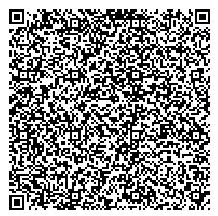
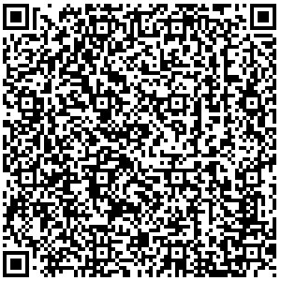
PASSENGER TRAVEL
Traffic Management Office (TMO)
Contact Information:
Email: 52LRS.LGRDAP.PassengerTravel@us.af.mil
DSN: 314-452-6661
Commercial: +49 6565-61-6661
NOTE: Our office is CLOSED for all U.S. Federal Holidays, USAFE Family Days, and the 3rd Wednesday of each month for training.
Contact
Information
Email Us

Slide 43
Questions?
Passenger Travel
Traffic Management Office (TMO)

Slide 44


FOREIGN
GOVERNMENT
EMPLOYMENT
(FGE)
All DAF separating/retiring service members must acknowledge:
Receipt of FGE/post government briefing
Joint approval required from SecAF and SecState prior to accepting employment with a foreign government or entity
DoD may withhold pay, allowances, or benefits and may revoke security clearance if found in violation
Circumstances requiring FGE approval are not always apparent; all transitioning service members must consult a legal/ethics official when considering employment that may be considered FGE
For additional information visit:
https://www.retirees.af.mil/Foreign-Government-Employment/
Notes:
*FGE is referenced in the Resource Guide but does not include the slides; DAF requires this to be included in Pre-Sep and on eForm.
A few highlights concerning Foreign Government Employment: All Department of the Air Force retirees must have a statement added in the remarks section that acknowledges approval by the Secretary of the Air Force and the Secretary of State is required prior to accepting employment with a foreign government or entity. Compensation without prior FGE approval is subject to recoupment (garnishment) from retired pay; and that you have been briefed concerning Post-military Employment restrictions and Foreign Government Employment Requirements. As always, remember to consult our installation JA with any questions/concerns.

Slide 45
FOREIGN
GOVERNMENT
EMPLOYMENT
(FGE)
DISCLAIMER:
This video is being presented on the YouTube platform which currently automatically embeds commercial advertisement videos. The Department of the Air Force does not receive revenue from these advertisements and the appearance of these commercial advertisements, information, products, or services represents the views of those advertisers and does not constitute endorsement by the Department of the Air Force or the Department of Defense which does not exercise any editorial control over the platform or the information
herein.
Notes:
You can access the video using the QR code on this slide. Read DISCLAIMER:
This video is being presented on the YouTube platform which currently automatically embeds commercial advertisement videos. The Department of the Air Force does not receive revenue from these advertisements and the appearance of these commercial advertisements, information, products, or services represents the views of those advertisers and does not constitute endorsement by the Department of the Air Force or the Department of Defense which does not exercise any editorial control over the platform or the information herein.

Slide 46

Post-Government Employment
https://youtu.be/fA5RRoiFduE
Integrity – Service - Excellence

Slide 47
Post-Government Employment
52FW/JA
Integrity – Service - Excellence

Slide 48
Agenda
Seeking Employment
Working on Terminal Leave
Non-Federal Post-Government Employment Restrictions
Foreign Employment Restrictions
Integrity – Service - Excellence

Slide 49

Seeking Employment
Prior to leaving Government service, Federal employees may begin their job search and engage in employment conversations with potential employers.
However, these employees must be careful to avoid financial conflicts of interest that may arise due to their continuing Government service.
KEY RULE: You may not take any official action that affects a company with which you are negotiating for employment or have an arrangement concerning prospective employment. See 18 U.S.C. § 208, 5 C.F.R. § 2635.402
Integrity – Service - Excellence
Notes:
Can’t make decisions on the F-35 while you’re seeking employ from Lockheed martin

Slide 50
Seeking Employment
You are “seeking employment” when you:
– engage in negotiations
– make unsolicited employment contact
• includes sending resume
• excludes requesting job application
– respond to unsolicited proposal (except unconditional rejection)
You are no longer “seeking employment” when:
– either party rejects proposal and discussions have terminated, or
– two months have passed after mailing resume and no response
DISQUALIFICATION: An employee must notify his or her supervisor, in writing, of employment contacts that may impact his or her duties and disqualify him/herself from any further involvement with matters involving those entities. This restriction applies to everyone (civilians, officers and enlisted personnel) in any career field or occupation.
Integrity – Service - Excellence

Slide 51
Terminal Leave
Active Duty personnel may work while on terminal leave, subject to the following restrictions:
Financial disclosure form filers (OGE 450/278) must obtain agency designee approval if employer will be prohibited source (use AF Form 3902)
Military officers working on terminal leave (like all Federal employees) are prohibited by 18 USC §205 and 18 USC §203 from representing their new employer to the Government.
  In almost every case, this precludes a member from interacting or appearing in the Federal workplace as a contractor. Being present in Government offices on behalf of a contractor is inherently a representation.
  Of course, military officers on terminal leave may begin work with the contractor, but only "behind the scenes" at a contractor office or otherwise away from the Government workplace.
  Enlisted members are not subject to 18 USC §§203 or 205
Integrity – Service - Excellence
Notes:
Prohibited Source
Is seeking official action by the employee's agency;
b. Does or seeks to do business with the employee's agency;
c. Is regulated by the employee's agency;
d. Has interests that may be substantially affected by performance or nonperformance of the employee's official duties; or
e. Is an organization a majority of whose members fit into one or more of these categories. 5 C.F.R. § 2635.203(d).

Slide 52
After Retirement/Separation
Representational Restrictions (18 U.S.C. § 207)
Upon leaving the Federal Government, employees are subject to additional CRIMINAL restrictions under this statute that may limit their interactions with the Federal Government on behalf of another person or entity.
Designed to curb “switching sides”
DOES NOT prohibit acceptance of employment
MAY restrict scope of employee’s post government activities
Procurement Integrity Act (41 U.S.C. 2101-2107)
Bars acceptance of compensation from contractor for 1 year after certain participation in procurement of:
contracts, subcontracts, modifications, and other actions > $10M
Integrity – Service - Excellence

Slide 53
Key Representation Bars
1-Year Cooling Off Period: Bars former senior employees (SES/GO) from communicating to or appearing before their former department or agency, on behalf of another person or entity, with the intent to influence official action for 1 year after ceasing to serve in a senior employee position.
Lifetime Ban: Bars all former employees from representing another before any Federal agency or court regarding particular matters involving specific parties in which they participated personally and substantially at anytime during Federal service.
2-Year Ban: Bars all former employees from representing before any Federal agency or court regarding particular matters involving specific parties that were under their official responsibility during their last year of Federal employment.
Integrity – Service - Excellence

Slide 54
Representational Restrictions
Key Definitions
“Particular matter” – includes a judicial or other proceeding, application, request
for a ruling or other determination, contract, claim, controversy, or investigation. Generally, does not include rulemaking, formulation of general policy, standards or objectives, or other matters of general application.
“Intent to influence” – seeking some discretionary action, ruling, benefit, or
approval. Does not include purely social contacts or requesting publicly available information.
“Participate personally and substantially” – to participate directly and significantly by
decision, approval, recommendation, rendering of advice or investigation. Includes actions of a subordinate if actually directed by the former employee.
“Official responsibility” – direct administrative or operating authority, whether
intermediate or final, and either exercisable alone or with others, and either personally or through subordinates, to approve, disapprove, or otherwise direct Government action.
Integrity – Service - Excellence

Slide 55
Procurement Integrity Act
The 1-year Ban on Accepting Compensation from the Contractor is triggered if the employee served in any of the following roles or made the following decisions:
ROLES
Served as a Procuring Contract Officer,
Source Selection Authority,
Source Selection Evaluation Board Member,
or Chief of Financial or Technical Evaluation Team for a procurement > $10M
Served as a Program Manager,
Deputy Program Manager, or
Administrative Contracting Officer for
procurement > $10M
DECISIONS
Personally made decision to:
Award a contract, subcontract,
modification, or task order > $10M
Establish overhead or other
rates applicable to contract > $10M
Approve issuance of a contract
payment > $10M
Pay or settle a contract claim >$10M
Integrity – Service - Excellence

Slide 56
Foreign Employment Restrictions
Military Retirees seeking employment/ compensation from a Foreign Government…
MUST OBTAIN CONSENT!
Under the Emoluments Clause of the U.S. Constitution retired military officers, enlisted personnel, and Reservists may not accept a payment from a foreign government without first obtaining the consent of Congress. Congress has determined that this consent should be obtained by asking for advance permission from the Secretary of State and the Secretary of the Military Department concerned before accepting the payment. For purposes of the Emoluments Clause, a corporation that is controlled by a foreign government is generally considered to be the same as the foreign government itself.
The penalty for violating the Emoluments Clause is suspension of a portion of (or in some instances all) retired military pay during the period of the violation.
AF Retirees considering employment by a foreign government should consult AFI 36-2913, Request for Approval of Foreign Government Employment (19 Nov 03). The responsible office is: HQ AFPC/DPFFF, 550 C Street West, Randolph AFB, Texas, 78150-4739. Telephone is COM 210-565-2273 or DSN 665-2273. Point of Contact is Ms. Tammy Hern.
Integrity – Service - Excellence

Slide 57
Questions?
Integrity – Service - Excellence
Notes:
30 day letter:
- Current and former employees who have been offered a definite position with a private employer may request a written legal opinion on whether the Procurement Integrity Act compensation ban applies to them.
- The ethics official ordinarily issues this legal review within 30 days of the request (hence, the name “30-day Letter.”)
- Employees are not required to have a 30-day letter in hand before they begin to talk to a company about employment, nor does the Government require that the employee obtain a 30-day letter at all, if the employee does not fall under a category described in paragraph (5) of the previous section.
- However, it is not unusual for a private employer to request that a former Federal official submit a letter during the interview process. For these occasions, we provide a “Certification of No Conflict” (Attachment 2), for submission to potential employers with a copy of your disqualification memorandum.
- The Air Force Ethics Office’s policy is that a 30-day letter will not be issued unless the employee or former employee has a definite description of duties to be performed and the job is contingent upon an ethics review.
- A request for a 30-day letter must be submitted on DD 2945 (see Attachment 3), signed and dated.
- The writing must explain the duties the employee recently held with the Federal government, as well as the duties the employee anticipates undertaking for the new employer.

Slide 58
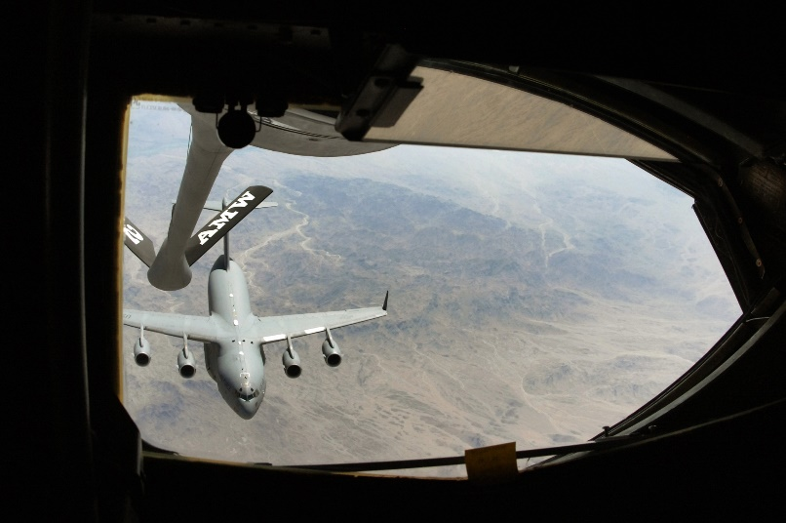
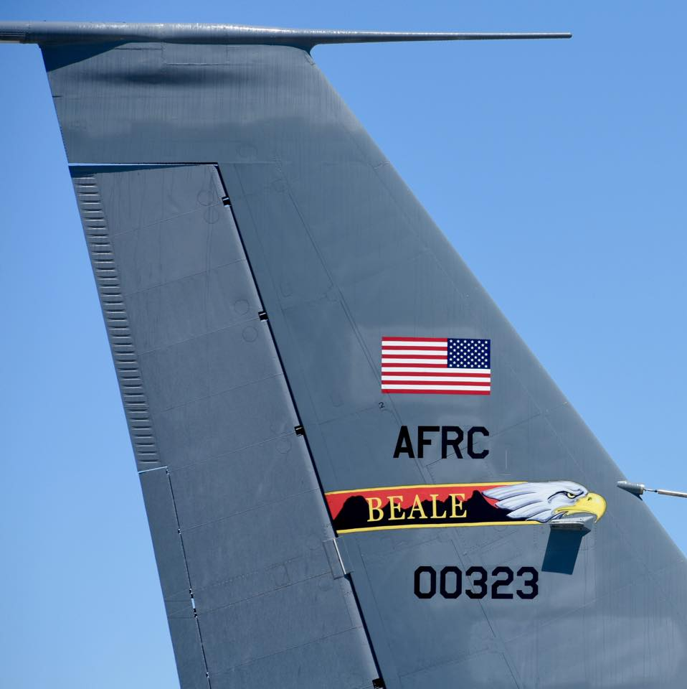
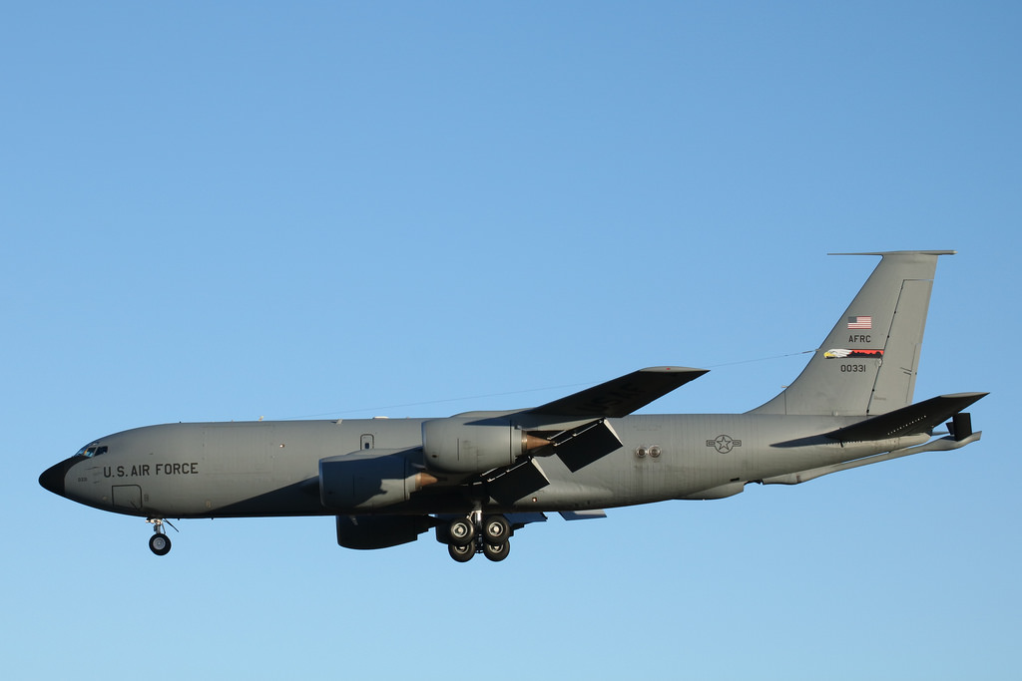

Slide 59
Overview
Programs in the Air Force Reserve
  (Part time & Full time)
Air Force Reserve Benefits
Family/Career/Reserve
Schedule Out Process

Slide 60
Part Time Participation Options
Traditional Reserve
  1 Weekend per Month
  1 Annual Tour (2 Weeks)
  Total: 39 Days
Individual Mobilized Augmentee (IMA)
  Flexible Schedule and DOES NOT have to be local.
  Ability to be attached to a unit geographically separated from your home of record.
  Serve 26 days/year IMAB or 38 days/year IMAA.

Slide 61
Full Time Participation Options
Air Reserve Technician (ART)
  Full time civil servant M-F.
  Reserve member 1 weekend per month.
  Two Retirements!
  www.usajobs.gov
Active Guard & Reserve (AGR)
  Same pay and benefits as active duty.
  Earn an active duty retirement after 20 years.
  myPers (Select “Air Reserve,” Click “Access AGR Program Information/Vacancies”)

Slide 62
Benefits
Maintain/renew/upgrade security clearance
SGLI (50k-400k)
Retirement= 20 years of service
NO testing for rank!
Cross-Training
Extra income
MGIB-SR(extra12 mos)/ Kicker ($350)/TA($4500)
Medical Insurance (Tricare Reserve)

Slide 63
Extra Monthly Income CY 2021
Rank/TIS Per UTA (weekend)
Capt w/6 yrs $841.56
TSgt w/8 yrs $501.68
SSgt w/6 yrs $424.96
SrA w/4 yrs $361.80
*Annual tour is Active Status w/base pay, BAH, BAS*

Slide 64

Rates by States

Slide 65
Transitional Assistance Management Program (TAMP)
180 days of premium-free healthcare benefits after separation from active duty.
Eligibility:
  Involuntarily separating from active duty under honorable conditions.
  Air National Guard or Reserve member separating from a period of more than 30 consecutive days of active duty served in support of a contingency operation.
  Separating from regular active duty service and agree to become a member of the of a Reserve Component. The member must become a Selected Reservist the day immediately following release from regular active duty service to qualify.

Slide 66
TRICARE Reserve Select (TRS)
http://www.tricare.mil/reserve/reserveselect/index.cfm
Pick your doctor
Individual Monthly Premium: $44.17
Family Monthly Premium: $228.27
Compare with civilian insurance plans at
      www.ehealthinsurance.com

Slide 67
Educational Benefits
Post 9/11 Transfer Eligibility
  Any member of the armed forces Active Duty or Selected Reserve and meets the following criteria:
    6 years in the Armed Forces (Active Duty and/or Selected Reserve) on the date of approval and agrees to serve four additional years in the armed forces from the date of election
    Transfer requests are submitted and approved while the member is in the armed forces
Air Force Reserve 100% Tuition Assistance
  100% for Undergraduate Degree Programs & Master’s Degree Programs
  Annual cap of $4,500.00
  Exact same program as Active Duty-apply through the AFPortal

Slide 68
GI Bill Reserve Select and Kicker
Monthly Rates (as of Oct 1, 2020)
Montgomery GI Bill-Selective Reserve
Full Time Rate $397.00
*12 Additional Months of Education Benefits after exhaustion of Post-911 GI Bill
GI Bill Kicker-Requires qualifying AFSC
Full Time Rate $350.00

Slide 69
Family-Career-Reserve
Priorities
Moving
Inactive Status
  Break in Service
Job Security
  Protection

Slide 70
Make your Out-processing appointment
*Required for All O-4 (Maj) and Below Members SEPARATING
MSgt Richard Mier
DSN: 314-452-6762
richard.mier.2@us.af.mil
WhatsApp 49-0160-5221174

Slide 71

Palace Chase
Palace Front
Brief
MSgt Ryan Persad
In-Service Recruiter
Comm:
+49 170 1740481
ryan.persad.1@us.af.mil

Slide 72



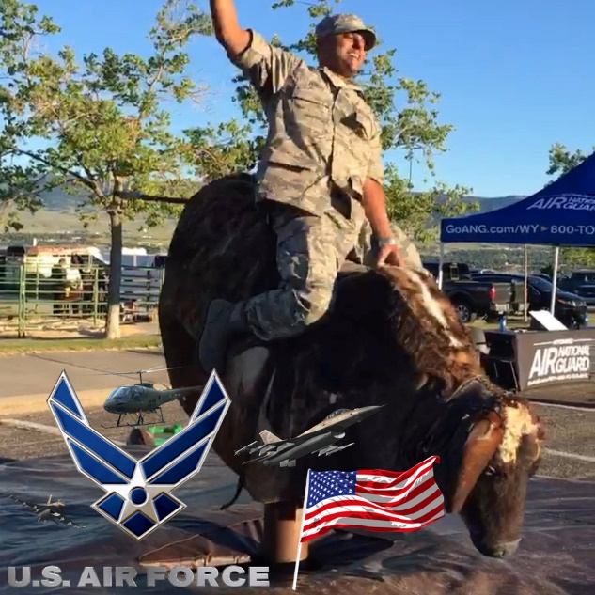


Slide 73
Benefits of joining the ANG
Focus on personal goals while continuing military service
Federal and State education benefits
Cross-training
Thrift Savings Plan (TSP)
Unlimited BX, commissary, gym, hobby shop, MWR, Space-A, and outdoor recreation
Service members Group Life Insurance (SGLI)
Health Care Coverage
Full time employment opportunities
Possible $30,000 affiliation bonus
Retirement age 60

Slide 74
More Benefits
MILITARY ID CARD/BASE PRIVILEDGES FOR YOU AND YOUR DEPENDANTS!
Chapel Used Car Lot Tennis Court
Library Golf Course Shooting Range
Theater Bowling Alley Swimming Pool
Auto Skills Recreation Center Aero Club
Base Exchange (Department Store! No taxes! Save up to 25% a year - ) http://www.aafes.com/
Gym (Sauna, Weights, Basketball, Aerobics. Absolutely free!)
Picnic Area (Rental Lodge/Lake/Softball/Basketball)
Shoppette (Convenience Store/Gas Station/Auto Repair Shop)
Self Help Hobby Shops (Ceramic Shop, Wood Shop, Auto Repair Shop, etc.)
Billeting (Military Hotel/Motel - Space Available!)
NCO Club (Meals, Social Occasions, Special Activities, etc.)
Rental Service (Sport/Lawn/Special Event Equipment, etc.)
Class VI (Military Package Store)
Commissary (Save up to 30% a year on groceries - www.commissaries.com)
Group Life Insurance (Up To $400,000) http://www.insurance.va.gov/miscellaneous/index.htm
Free Uniforms and Replacement
20 Year Retirement plus Thrift Saving Plan (401K Type Plan - www.tsp.gov)
Opportunity To Travel (Earn Money While You Travel)
VA Housing Loan (http://www.homeloans.va.gov/)
Health and Dental Insurance Programs (http://www.tricare.mil)
Free Lodging on Drill Weekend (If you live over 50 miles away from base)
Civilian Job Rights and Protection (http://www.esgr.org/)

Slide 75
O more Benefits….
“BENEFITS!”
Honor Serving Your Country And State
Fair, Impartial Treatment For All
Interactions With Working Professionals
Member Of A Profession Highly Respected By The American Public
PRIVILEGES RESERVED ESPECIALLY FOR YOU!
“MONEY”
Pay raises
Annual cost of living allowance
Annual seniority pay increase for every other year served
Unit Training Assembly/One weekend a month (4 days of active duty base pay)
Deployments – Opportunity to travel and make extra money!
Monthly salary at TTS (Active Duty pay) if required for retraining
Full-time employment opportunities
Military Pay Information Line (www.defenselink.mil/militarypay)

Slide 76
Family time
School time
Valuable training for your Career of your choice ( crazy huh )
Exchange for one weekend a month and two weeks a year
  39 Days of work in your career field, in a year, minimum

Slide 77
Who is the Air National Guard?
Our Federal Role
To support national security objectives
Our State Role
To protect life, property, preserve peace, order and public safety
*Still one weekend a month+ 2 weeks out of the year = 39 Days a year!

Slide 78


Slide 79
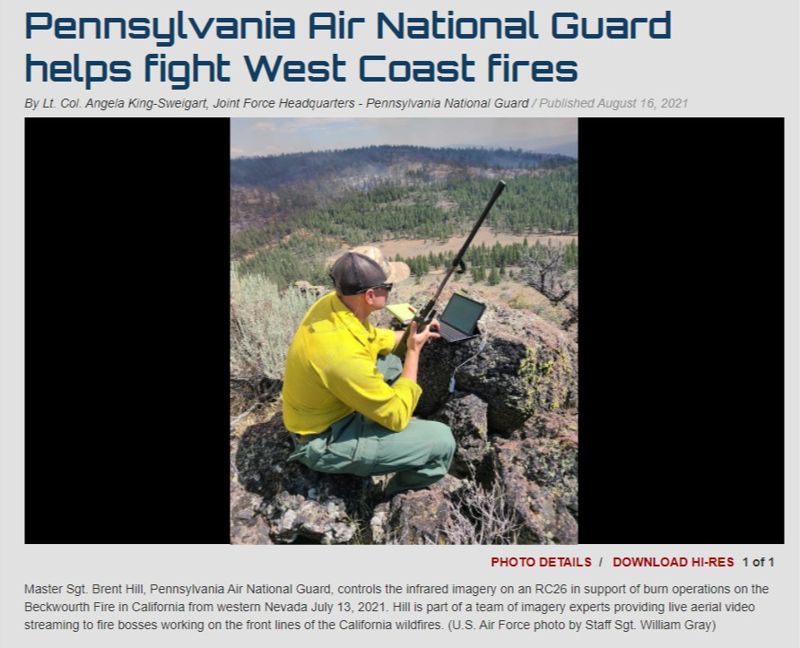

Slide 80
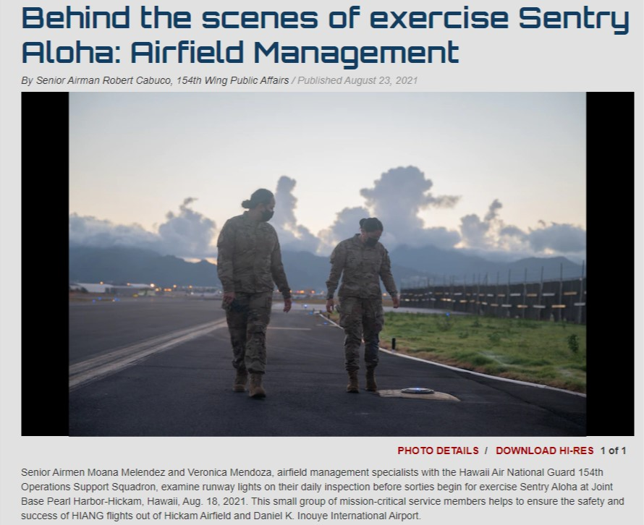

Slide 81
Full-Time Opportunities
Active Guard Reserve (AGR). Military Vacancy Announcements, Active Guard Reserve (AGR), Active Duty for Operational Support Positions found at: https://www.ang.af.mil/Careers/State-Active-Guard-Reserve/
Full-Time Federal Technician positions can be found at: https://www.usajobs.gov/
To find a phone number to the recruiting team in a specific state: https://www.goang.com/locations.html
AGR and Federal/State Positions can be found on each state’s website (some websites do not open on a government computer):

Slide 82
Full-Time Opportunities
Alabama: https://al.ng.mil/ALABAMA/Careers/HRO/Pages/agr.aspx
Alaska: https://dmva.alaska.gov/HRO/AGR
Arizona: https://dema.az.gov/careers/azng-human-resources/jobs-agr
Arkansas: https://arkansas.nationalguard.mil/Careers/Current-Openings/Air-AGR/
California: https://calguard.ca.gov/air/
Colorado: http://co.ng.mil/jobs/Pages/default.aspx
Connecticut: http://ct.ng.mil/Careers/Pages/default.aspx
Delaware: https://www.de.ng.mil/join/careers/
District of Columbia: http://www.113wg.ang.af.mil/Resources/Careers.aspx
Florida: https://www.ang.af.mil/Careers/State-Active-Guard-Reserve/
Georgia: (site under maintenance)
Guam: (site under maintenance)
Hawaii: http://dod.hawaii.gov/hro/job-vacancy-announcements/agr-vacancies/
Idaho: https://inghro.idaho.gov/Jobs.htm
Illinois: http://www.il.ngb.army.mil/Employment-Opportunities/
Indiana: https://www.in.ng.mil/Careers/Jobs/
Iowa: https://www.iowanationalguard.com/Jobs/Pages/Home.aspx
Kansas: http://www.kansastag.gov/FED_jobs_agr.asp
Kentucky: https://www.123aw.ang.af.mil/Contact-Us/Careers/

Slide 83
Full-Time Opportunities
Louisiana: http://geauxguard.la.gov/join-us/agr/air/
Maine: http://www.me.ngb.army.mil/Careers/
Maryland: http://military.maryland.gov/hro/Pages/HRO-Home.aspx
Massachusetts: http://www.thenationsfirst.org/available-positions.html
Michigan: http://minationalguard.dodlive.mil/available-jobs/
Minnesota: https://minnesotanationalguard.ng.mil/full-time-jobs-in-minnesota/
Mississippi: http://ms.ng.mil/careers/Pages/default.aspx
Missouri: http://www.moguard.com/current-job-listings/
Montana: https://www.120thairliftwing.ang.af.mil/Recruiting/
Nebraska: https://ne.ng.mil/Resource/Pages/Job-Announcements.aspx
Nevada: https://nv.ng.mil/SitePages/departments/human-resources.html
New Hampshire: (site under maintenance)
New Jersey: http://www.nj.gov/military/vacancy/
New Mexico: https://www.150sow.ang.af.mil/About-Us/Careers/
New York: http://dmna.ny.gov/jobs/?id=agr
North Carolina: http://nc.ng.mil/resources/careers/Pages/Careers.aspx
North Dakota: https://www.ndguard.nd.gov/job-opportunities
Ohio: https://hr.ong.ohio.gov/Job-Postings/AirNationalGuard
Oklahoma: https://ok.ng.mil/careers

Slide 84
Full-Time Opportunities
Oregon: https://www.oregon.gov/omd/Pages/Careers.aspx
Pennsylvania: https://www.pa.ng.mil/Offices-Programs/Human-Resources/Jobs-Employment/
Puerto Rico: (site under maintenance)
Rhode Island: https://www.143aw.ang.af.mil/About-Us/Careers/
South Carolina: https://www.169fw.ang.af.mil/Careers/Swamp-Fox-Vacancies/
South Dakota: https://sd.ng.mil/Careers/Pages/default.aspx
Tennessee: https://www.tn.gov/military/programs-benefits/employment-assistance/usajobs.html
Texas: https://tmd.texas.gov/tmd-jobs
Utah: https://ut.ng.mil/Employment/Job-Board/
Virgin Islands: (site under maintenance)
Vermont: https://www.158fw.ang.af.mil/CAREERS/OPPORTUNITIES/
Virginia: https://va.ng.mil/employment/Pages/VANGHRO.aspx
Washington: https://mil.wa.gov/washington-air-national-guard-traditional-jobs
West Virginia: http://www.wv.ng.mil/HRO/
Wisconsin: http://dma.wi.gov/DMA/humanresources/fedhr/agr
Wyoming: http://wyomilitary.wyo.gov/employment/air/

Slide 85
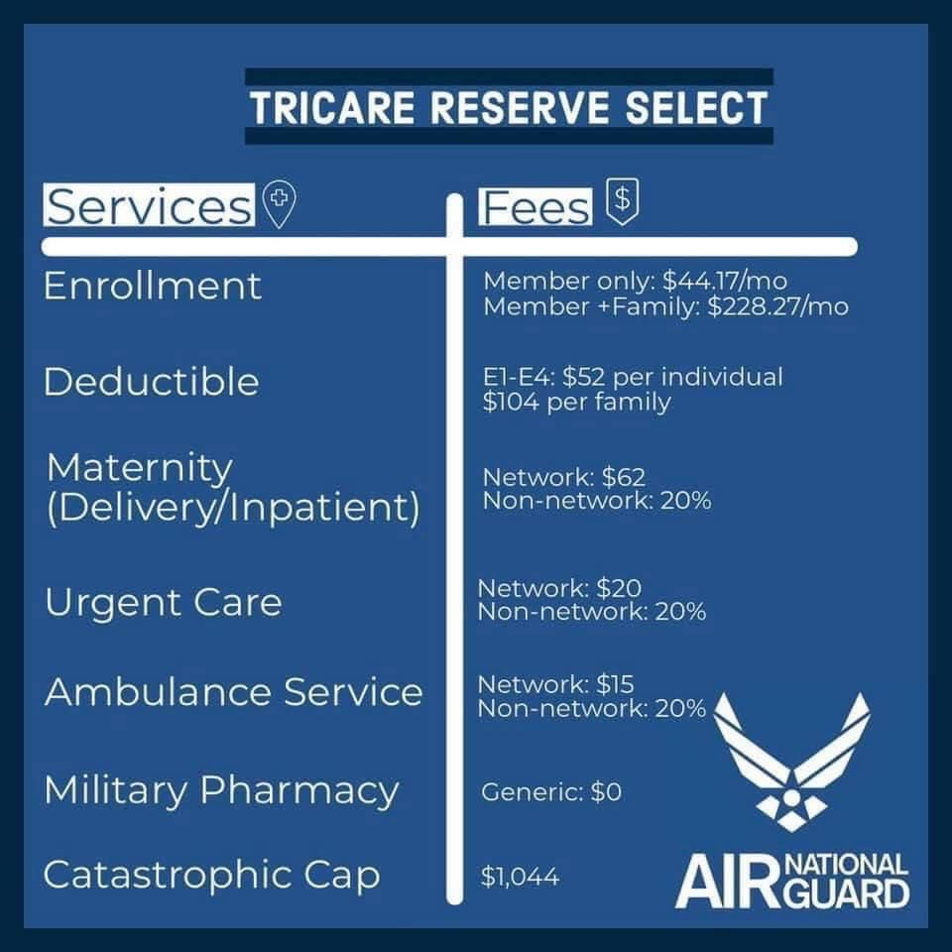
Who needs Insurance

Slide 86
Insurance
  Tricare Reserve Select: www.tricare.mil/cost
    Cost as of 22 May 2022
    Member only: $47.20 (Nat’l Avg is $289.43+)
    Family and member: $238.99 (Nat’l Avg is $574.67+)
  Tricare Dental Program: https://www.uccitdp.com/
    Member only $11.54
    Member and Family $31.04

Slide 87
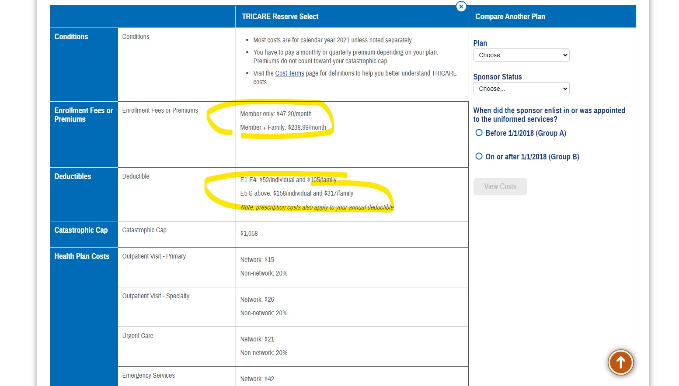

Slide 88
How can you apply?
AFI 36-3205
Palace Front: allow airmen to transition into the ANG after completing their active duty service commitment
  Talk to me ASAP
Palace Chase: allow airmen to honorably exit active duty early and serve out their contract part-time in the ANG;
  2 years for 1 Year AD Enlisted
  3 years for 1 Year AD Officers
Double for what ever you owe on Active Duty in the Guard

Slide 89
Palace Chase Eligibility
  Enlisted, complete 1/2 of initial enlistment
  Officers, complete 2/3 of initial ADSC
  No PCS orders (except when stationed overseas)
  Cannot be scheduled/notified of deployment, TDY or PME
  No Control Roster
  No medical profile (except pregnancy)
  No referral EPRs/OPRs
  Not within 6 months of Date Of Separation- (you would Palace Front)
  Valid security clearance
  Current fit test of 75% or higher

Slide 90
Palace Front Eligibility
  Current fit test of 75% or higher
  No medical profile (except pregnancy)
  Honorable discharge with a qualifying re-enlistment code
  Valid security clearance

Slide 91


MSgt Ryan Persad
In-Service Recruiter
Comm:
+49 170 1740481
ryan.persad.1@us.af.mil

Slide 92
MSgt Ryan Persad
In-Service Recruiter
Comm:
+49 170 1740481
ryan.persad.1@us.af.mil

Slide 93

U.S. Department of Veterans Affairs
Veterans Benefits Administration (VBA)
Pittsburgh Regional Office (RO)
Landstuhl, Germany

Slide 94
Benefits Delivery at Discharge (BDD)
OVERVIEW
Things to do to prepare if you are currently more than 180 days from separation:
1. Create a VA.gov account
2. Obtain a complete copy of your Service Treatment Records (STRs):
  Medical (inpatient and outpatient)
  Behavioral Health
  Dental and Vision records, if applicable
3. Prepare a list of the chronic conditions you plan to claim

Slide 95
BDD – Eligibility Requirements
You must have between 90-180 days remaining on active duty (ETS/retirement
date, not terminal leave) at the time your claim is submitted.
2. You must be available for 45-60 days immediately following the submission of
your claim to attend required VA examinations.
3. You must submit a complete copy of your service treatment records (STRs) to
include behavioral health, dental, or vision records if filing a claim for a disability
within these specialized areas.
4. Effective 01 April, participation in the BDD program requires the submission of a complete/signed Separation Health Assessment (SHA) Part A.

Slide 96
Process / Submitting a Claim
To ensure timely and seamless processing of your claim, please follow these step-by-step instructions.
I. Request a complete copy of your STRs from the Patient Administration Desk at the local Troop Medical Clinic/Hospital.
Some records may be stored in a separate location from your primary medical
file:
  • Military entrance physical
  • Inpatient records
  • Behavior Health records
  • Dental records (applicable only if claimed)
IMPORTANT: Tricare online records are not considered a complete copy of your
STRs, they do not contain all necessary elements noted above.

Slide 97
Process / Submitting a Claim
II. Claims Submission
The VA has three (3) platforms for Service Members and Veterans to submit a disability application and required supporting evidence (STRs, SHA Part A, etc.):
1. VA.gov
➢ After indicating you are on active duty and providing your future release from active-duty date, VA.gov will allow you to begin the claims application.
➢ International phone numbers cannot be entered on VA.gov. However, if you have an international phone number listed on your SHA Part A, we will use that number as your primary point of contact.
2. Quick Submit
➢ If you're unable to submit your application, STRs, SHA Part A, and supporting documents through VA.gov, you can submit them via Quick Submit.

Slide 98
Process / Submitting a Claim
3. Mail or Fax
➢ As a last resort, applications and supporting documents may be mailed or
faxed to the VA’s Claims Intake Center.
Mail
Department of Veterans Affairs
Claims Intake Center
PO Box 4444
Janesville, WI 53547-4444
Fax
Toll Free Fax: 844-531-7818
DID Fax: 248-524-4260
Required application/documents: VA Form 21-526EZ (Application for Disability Compensation and Related Compensation Benefits) Separation Health Assessment (SHA) Part A – Medical Self-Assessment, Service Treatment Records (complete copy)

Slide 99

Benefits Delivery at Discharge (BDD)
Should you wish to have a VA Representative assist you prior to submitting a claim and
you are within 180 days of active-duty separation, we are available Monday – Friday
from 9:00 am to 1600.
  1. If you are within driving distance of our Landstuhl office, we encourage walk-ins
  on Monday through Friday from 0900-1130 and 1300-1600.
  2. If you are not within driving distance of our Landstuhl office, you may schedule a
  telephone appointment via Visitor Engagement Reporting Application (VERA).
  Please add a comment in the special request section with your phone number (to
  include country code).
If a medical records review appointment is desired, the VA will need a copy of your service treatment records prior to an in-person or phone interview. A copy of your records must be electronically submitted via VA.gov or Quick Submit.

Slide 100
Location / Contact Information
VA’s Germany BDD Intake site is located at:
Landstuhl Regional Medical Center (LRMC)
Bldg. 3724 Room 110-114
Email: germanybdd.vbapit@va.gov
Phone: DSN 314-590-8200
Commercial: +49 (0) 06371 9464 8200
To receive regular overseas updates and information, please view and sign up to receive the VA’s OCONUS newsletter:
https://content.govdelivery.com/accounts/USVAVBA/bulletins/27fbc0d

Slide 101

Questions

